Slide 1
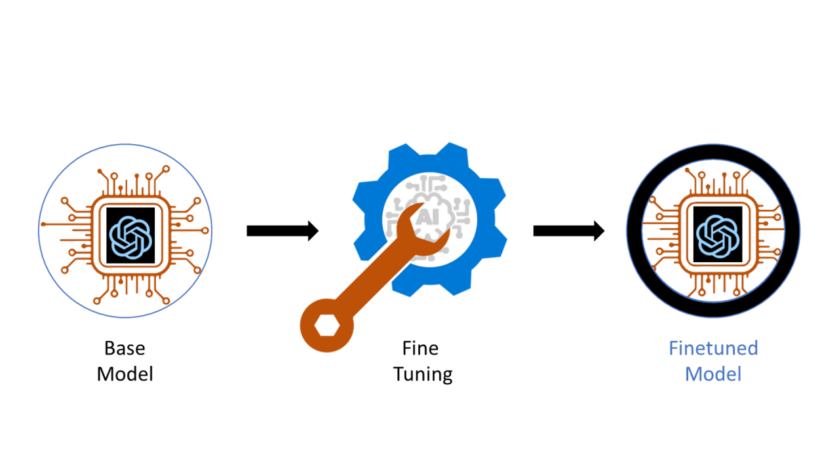
Speculative Decoding & Medusa
2.11.2026

Slide 2
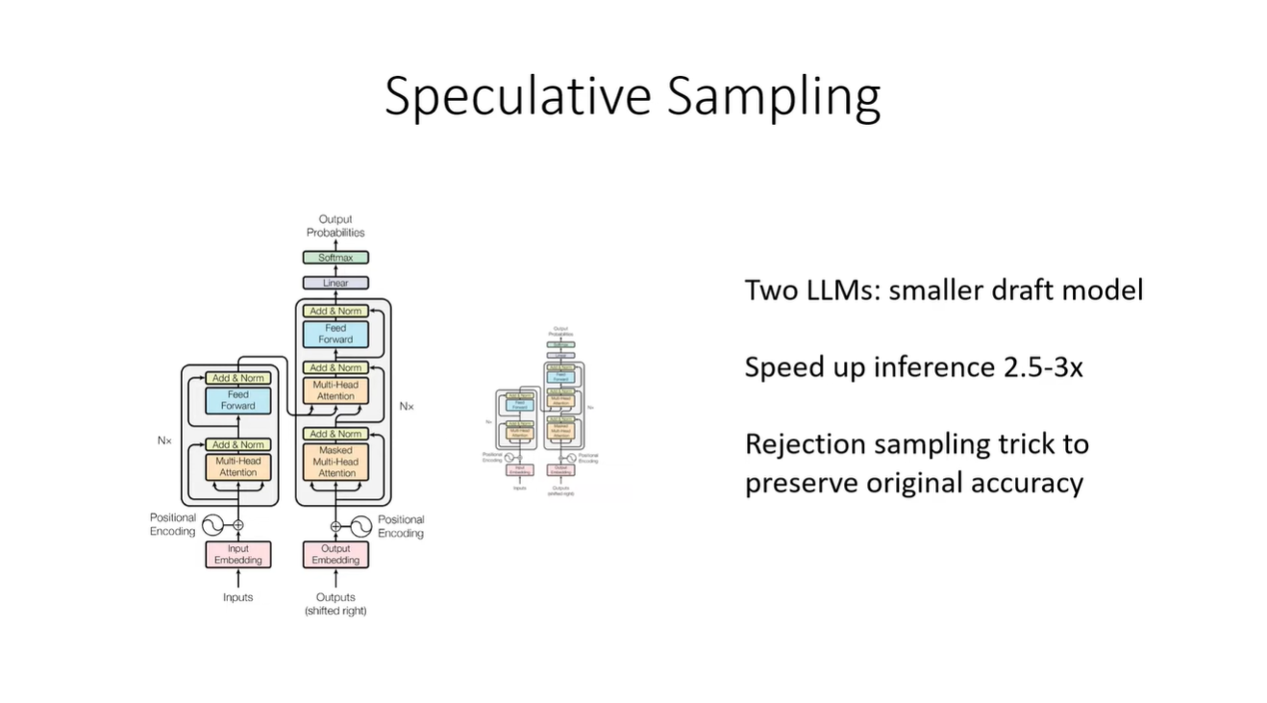
Fast Inference from Transformers via Speculative Decoding (18 May 2023)
1/23
Notes:
Running two transforms at the same time
Original model and draft model
Rejection sampling uses a neat mathematical manipulation called rejection sampling that enables the use of the two models while preserving the accuracy

Slide 3
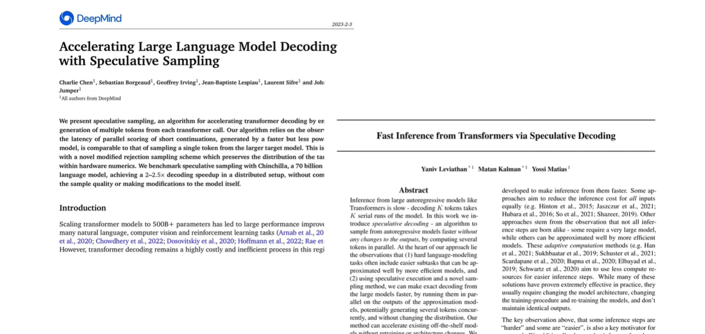
Fast Inference from Transformers via Speculative Decoding (18 May 2023)
2/23
Notes:
Goodle and deep mind published the same idea around the same time independently. The logic of the algorithms are identical in logic. Deepmind paper is easier to read but the google paper has some really nice mathematical breakdown. Today we will be looking at the google paper but with insights from the deep mind paper as well

Slide 4
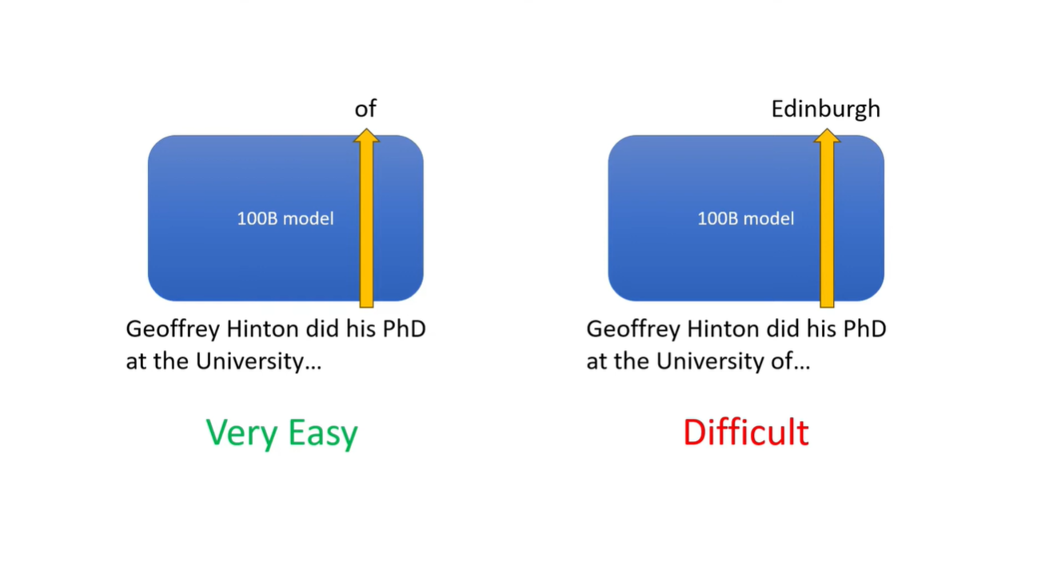
Fast Inference from Transformers via Speculative Decoding (18 May 2023)
3/23
Notes:
Doing a forward pass for an easy token generation will take the same time as a difficult token. There are more easier tokens than difficult tokens so it would be better to use a smaller model that can generate the easier tokens with a relative ease and generate the more difficult tokens with a larger model.

Slide 5
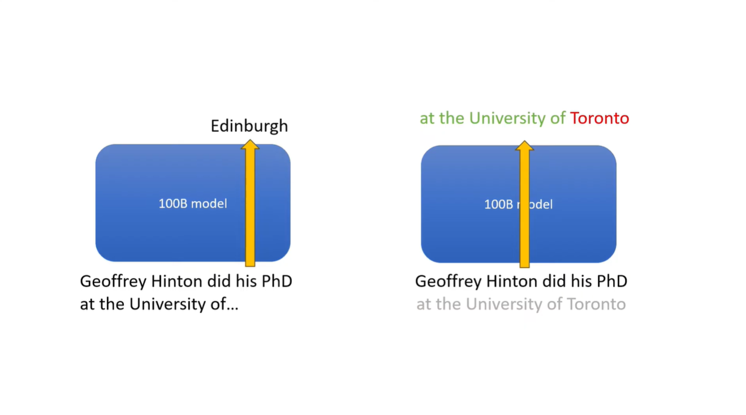
Fast Inference from Transformers via Speculative Decoding (18 May 2023)
4/23
Notes:
The forward pass generates the probability for a single token or a sequence of token with roughly the same amount of compute. In this case the probability of Toronto will be low because based on the training data Edingburg is the correct next word

Slide 6
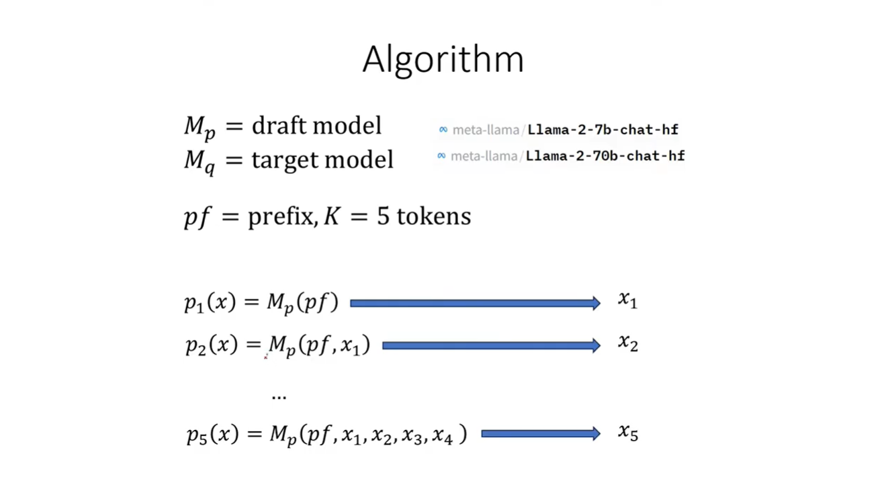
Fast Inference from Transformers via Speculative Decoding (18 May 2023)
5/23
Notes:
The draft model is the smaller one and the target is the bigger one. Given a prefix we use the draft model to generate the next 5 tokens. The model produces a probability model over the vocabulary and we sample the probability distribution to get the next token. This is run for k = 5 steps to get the next 5 tokens.

Slide 7
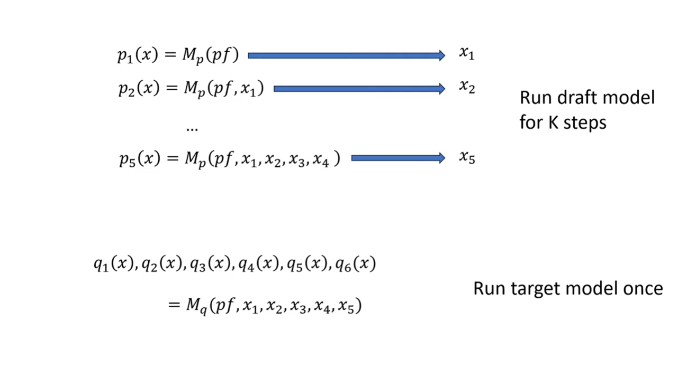
Fast Inference from Transformers via Speculative Decoding (18 May 2023)
6/23
Notes:
Next step is to run the target model using all of the tokens generated by the draft model as well as the next token to get a probability distribution. All of this is accomplished in just 1 forward pass

Slide 8
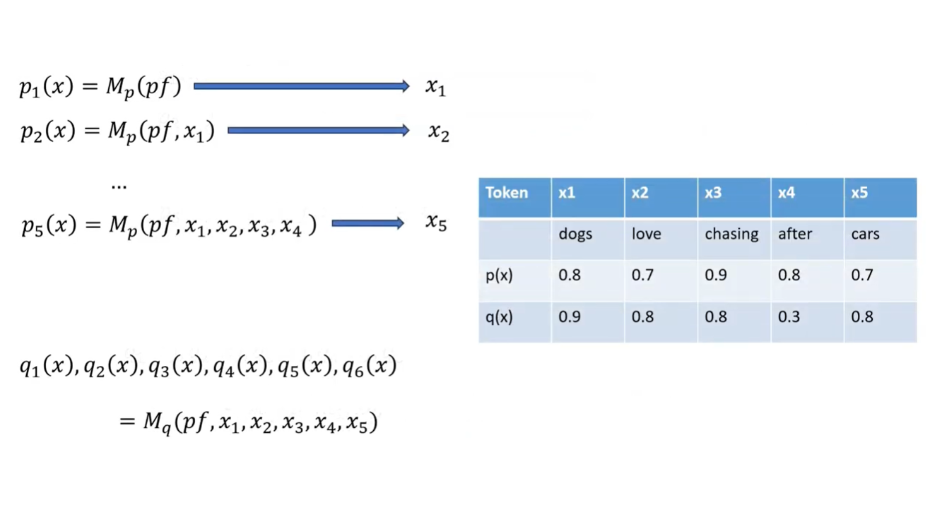
Fast Inference from Transformers via Speculative Decoding (18 May 2023)
7/23
Notes:
Sampling is not done with the larger model – just the forward pass to generate the probability model. All tokens generated are from the draft model. These probabilities are then used in rejection sampling

Slide 9
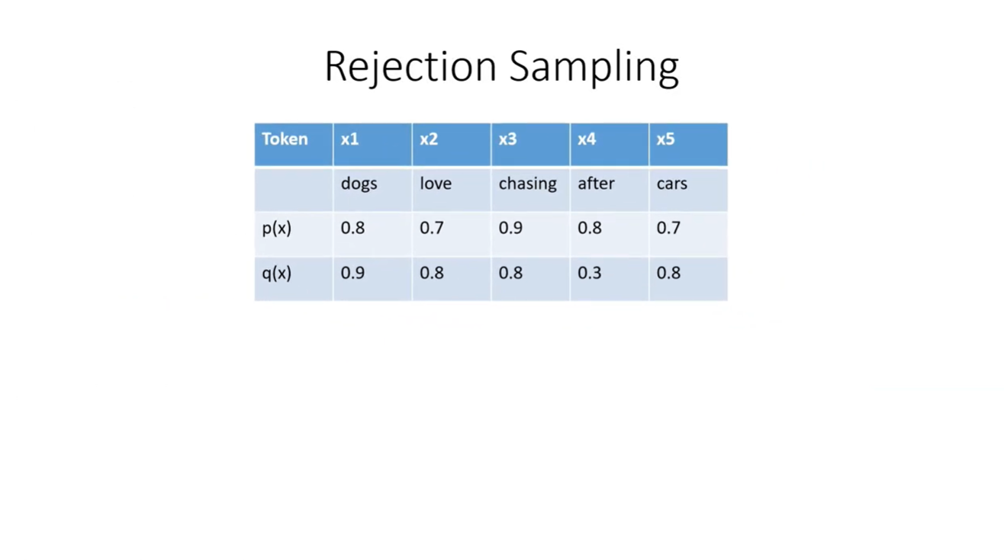
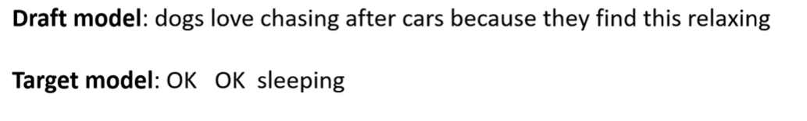
Fast Inference from Transformers via Speculative Decoding (18 May 2023)
8/23
Notes:
Evaluate each token based on the probabilities each of the two models assigned to it to determine whether to accept or reject. Best case we accept all worst case we reject the first token. The acceptance loop is broken once a token gets rejected because the tokens that follow were based on the assumption that the rejected token was correct

Slide 10
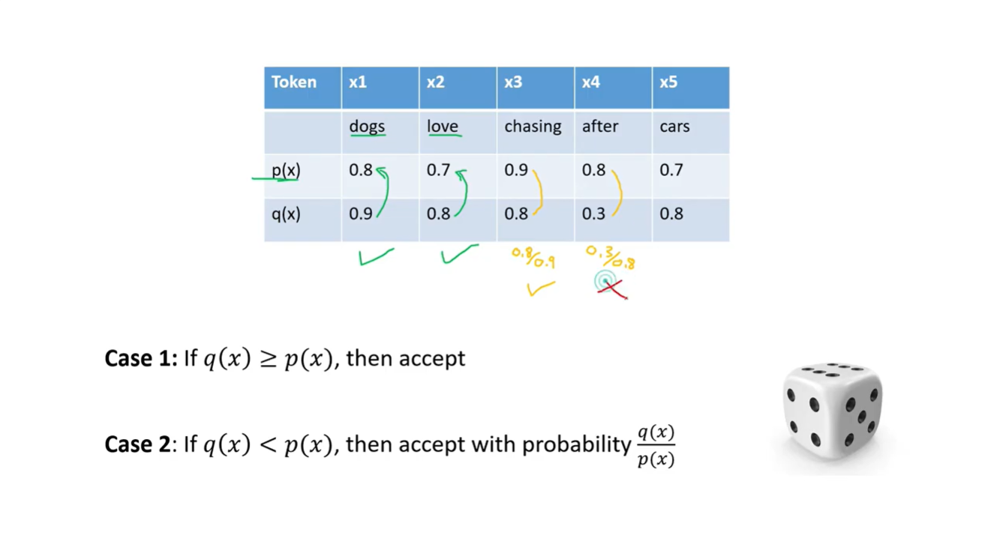
Fast Inference from Transformers via Speculative Decoding (18 May 2023)
9/23
Notes:
First token is accepted because the target model shows that there is a higher probability than even the guess made by the draft model. For x3 we roll a dice with the probability 8/9 which is around 90% so this one is more likely to be accepted than rejected. The next one will most likely be rejected and we exit the loop and have the draft model generate another 5 tokens using the q(x) last token and the existing tokens as a prefix and continue the loop

Slide 11
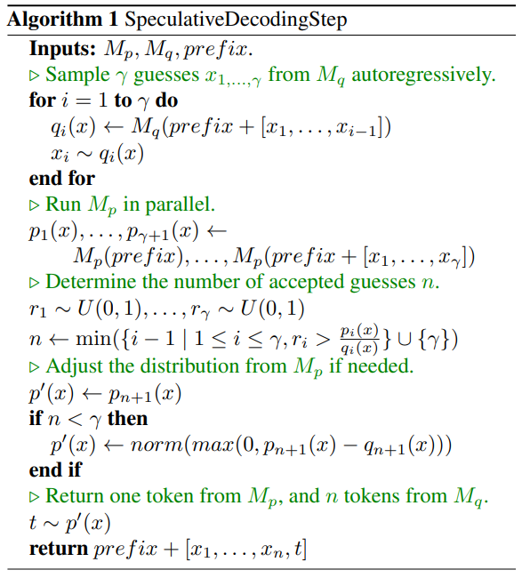
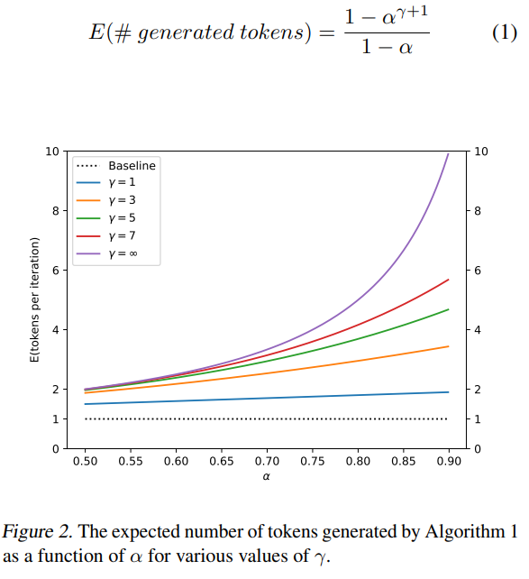
Fast Inference from Transformers via Speculative Decoding (18 May 2023)
10/23
Notes:
The algorithm tries to generate several tokens in one go. It keeps tokens only if they are accepted. If a token is rejected, generation stops for that step.
So: Higher acceptance probability (𝛼) and more speculation (γ) → more tokens generated per step

Slide 12
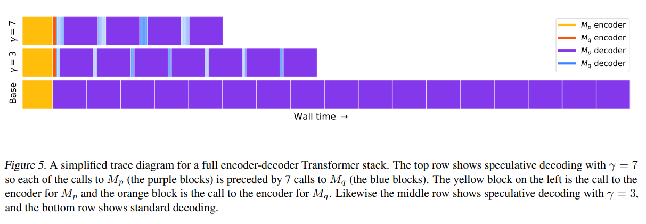
Fast Inference from Transformers via Speculative Decoding (18 May 2023)
11/23
Notes:
Why this works
The small model is cheap, so guessing extra tokens is okay
The large model is expensive, so we want to call it less often
Speculative decoding:
Trades cheap extra guesses for fewer expensive checks
Key intuition (one sentence)
Instead of asking the slow model for one token at a time, speculative decoding lets a fast model guess several tokens and asks the slow model to verify them all at once—saving ti

Slide 13
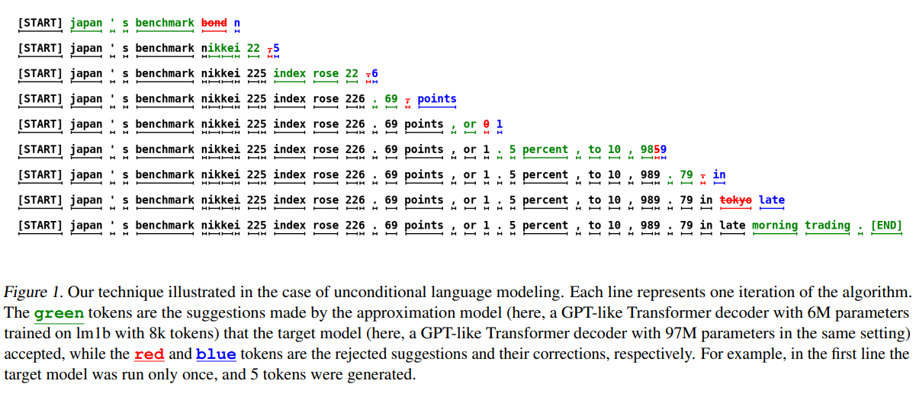
Fast Inference from Transformers via Speculative Decoding (18 May 2023)
12/23

Slide 14
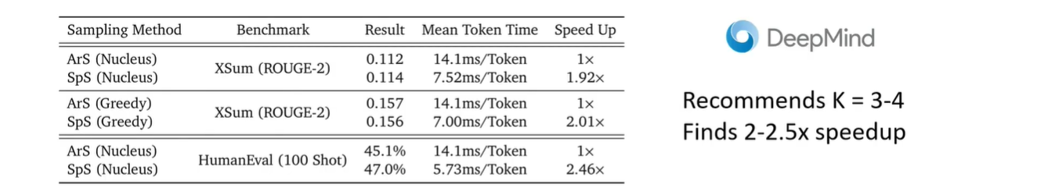
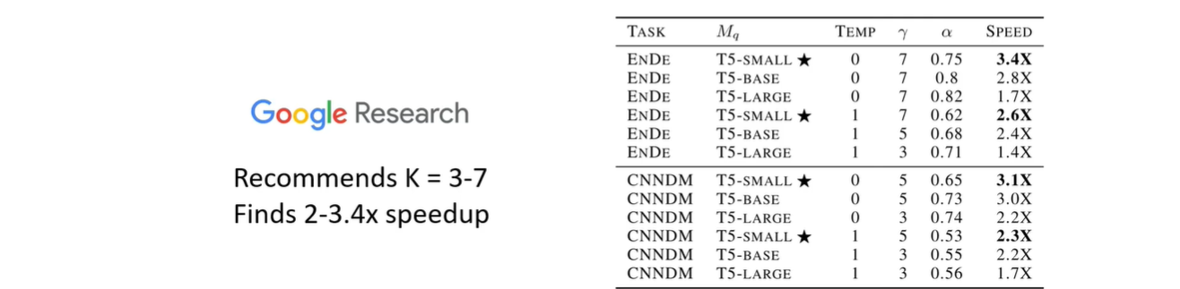
Fast Inference from Transformers via Speculative Decoding (18 May 2023)
13/23

Slide 15
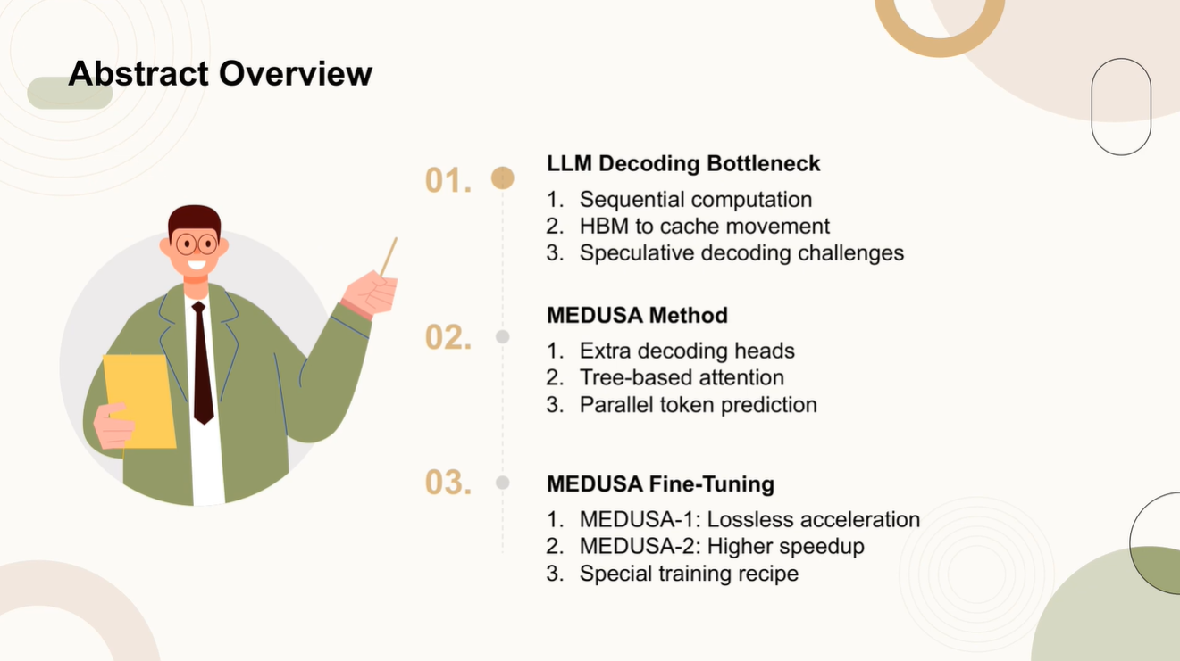
Medusa: Simple LLM Inference Acceleration Framework with Multiple Decoding Heads (14 Jun 2024)
13/23
Notes:
High Bandwidth Memory to cache presents a bottleneck. Implementation hurdles due to the need for a separate draft model. Extra decoding heads to predict multiple tokens in parallel. Medusa 1 - Finetune on frozen backbone.
Quality of language generation improves with model size. Causes inference latency – challenges practical application

Slide 16
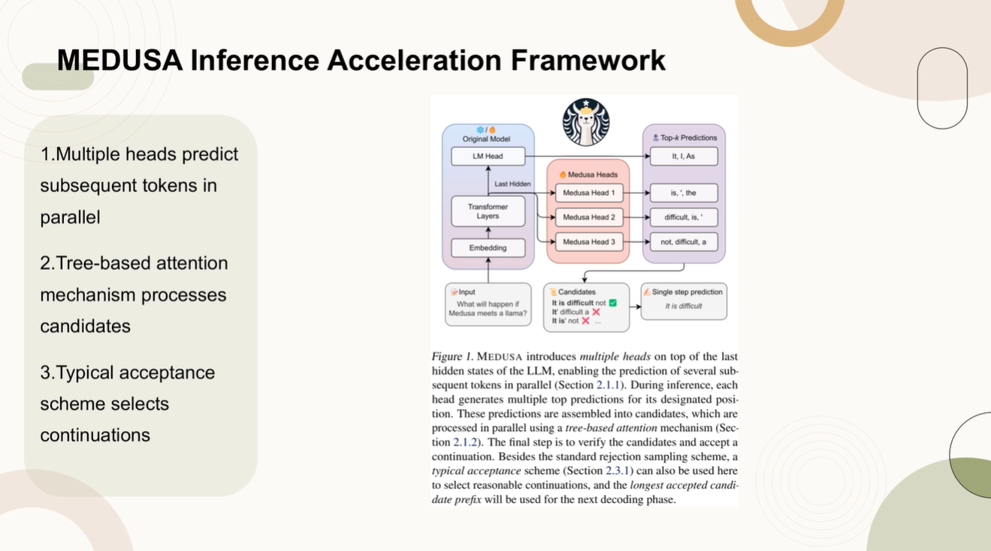
Medusa: Simple LLM Inference Acceleration Framework with Multiple Decoding Heads
14/23

Slide 17
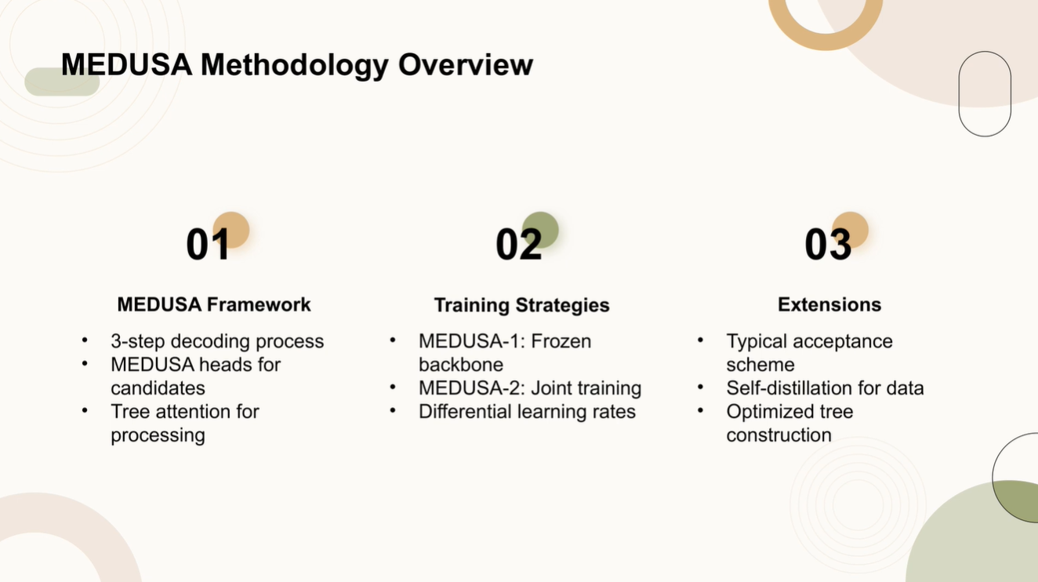
Medusa: Simple LLM Inference Acceleration Framework with Multiple Decoding Heads
15/23

Slide 18
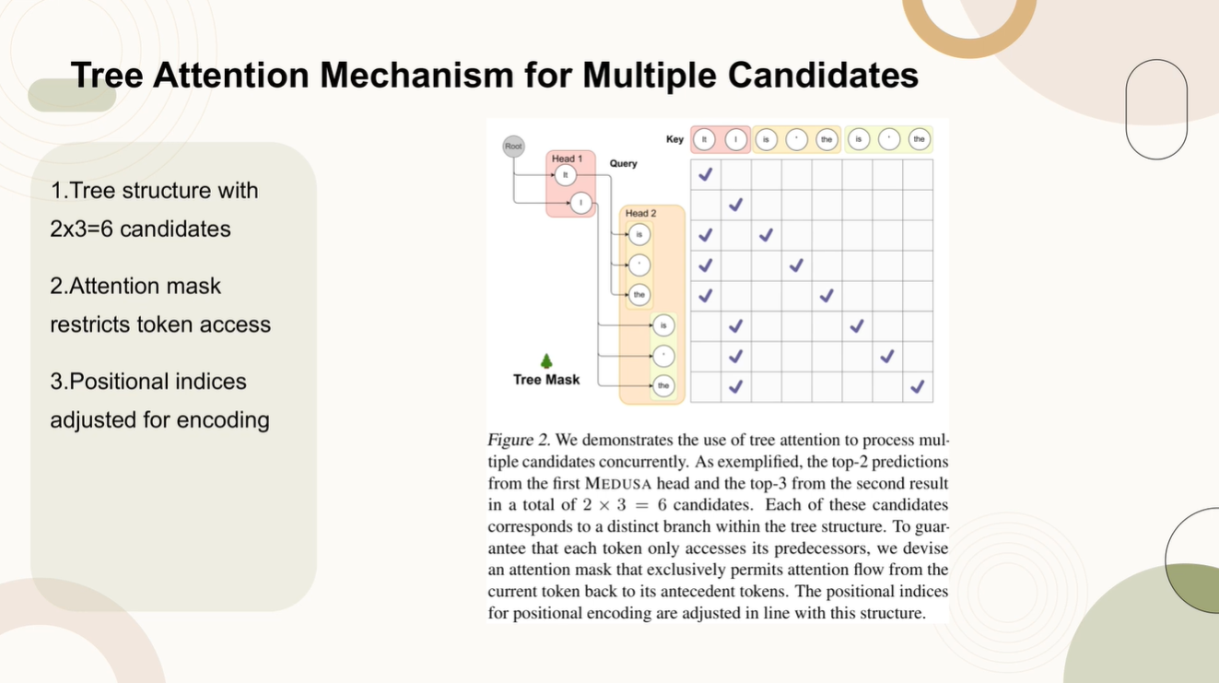
Medusa: Simple LLM Inference Acceleration Framework with Multiple Decoding Heads
15/23

Slide 19
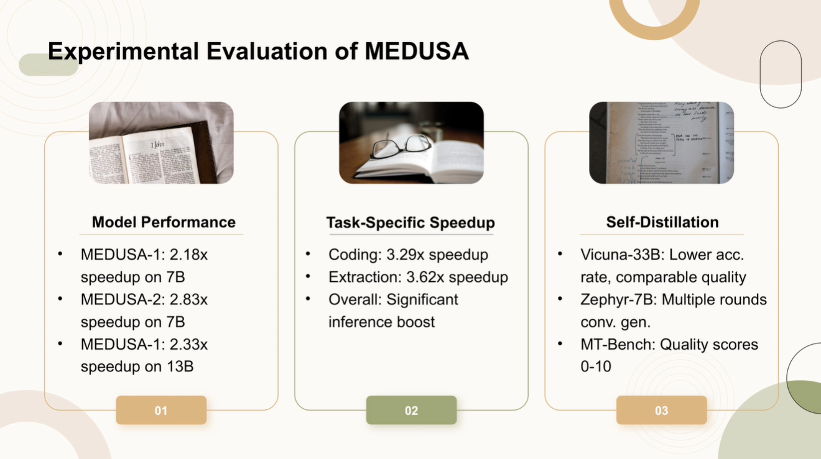
Medusa: Simple LLM Inference Acceleration Framework with Multiple Decoding Heads
16/23

Slide 20
Medusa: Simple LLM Inference Acceleration Framework with Multiple Decoding Heads
🔹 Vicuna-33B: Lower accuracy rate, comparable quality
The 33B-parameter model doesn’t always match exact answers (lower accuracy)
But humans judge its responses as similarly good
Meaning: It sounds good, even if it’s not always exactly correct
🔹 Zephyr-7B: Multiple rounds conversational generation
The 7B model is trained through multiple conversation turns
It learns to:
Respond
Follow up
Stay consistent across dialogue
This improves chat behavior, not just single answers
🔹 MT-Bench: Quality scores 0–10
MT-Bench is a human-style evaluation test
Scores answers from 0 (bad) to 10 (excellent)
Used to compare how good responses feel to users, not just correctness
Big takeaway (one sentence)
Self-distillation lets smaller models sound almost as good as larger ones by learning from them, even if they’re slightly less accurate.
17/23

Slide 21
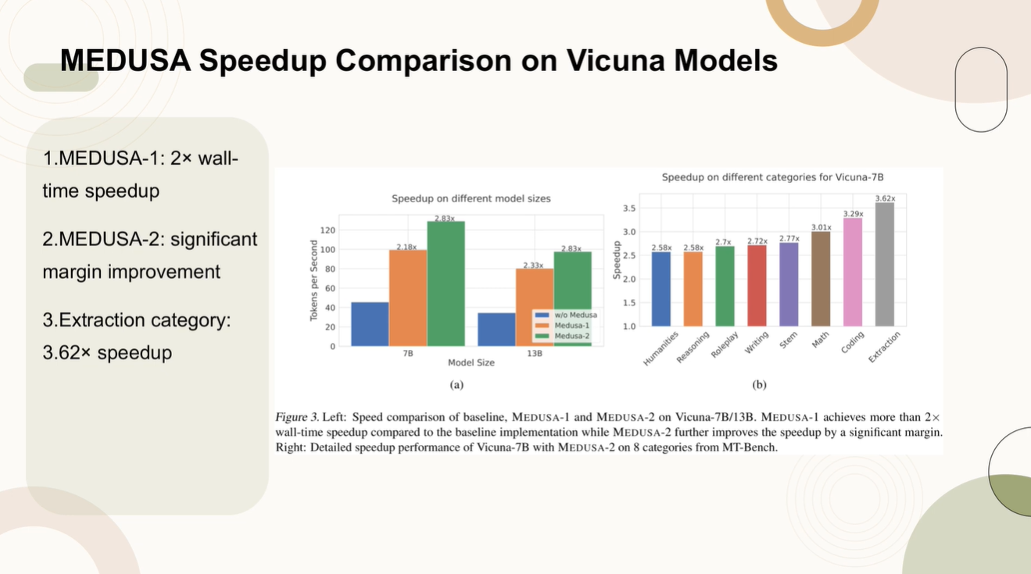
Medusa: Simple LLM Inference Acceleration Framework with Multiple Decoding Heads
Why Humanities is harder to speed up
1️⃣ More open-ended language
Humanities tasks (essays, interpretations, opinions):
Have many valid ways to continue
Small wording changes can be equally correct
➡ The fast “guessing” model disagrees more often with the main model.
18/23

Slide 22
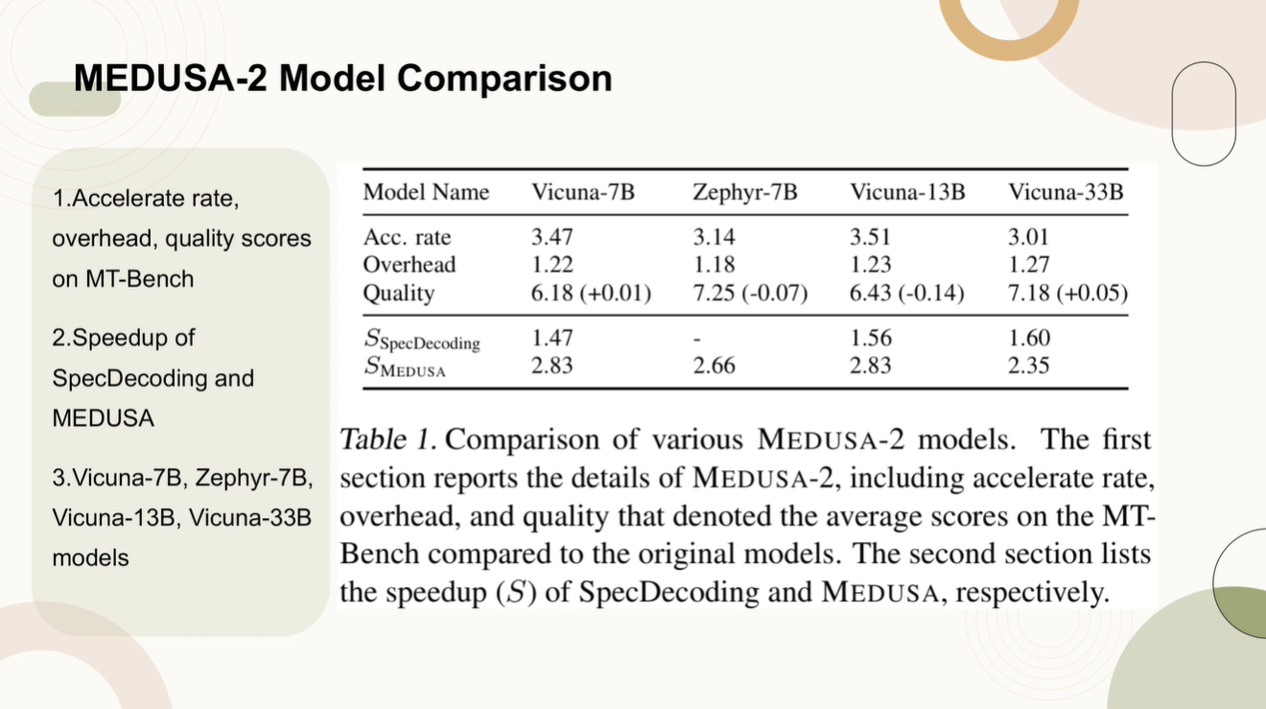
Medusa: Simple LLM Inference Acceleration Framework with Multiple Decoding Heads
19/23

Slide 23
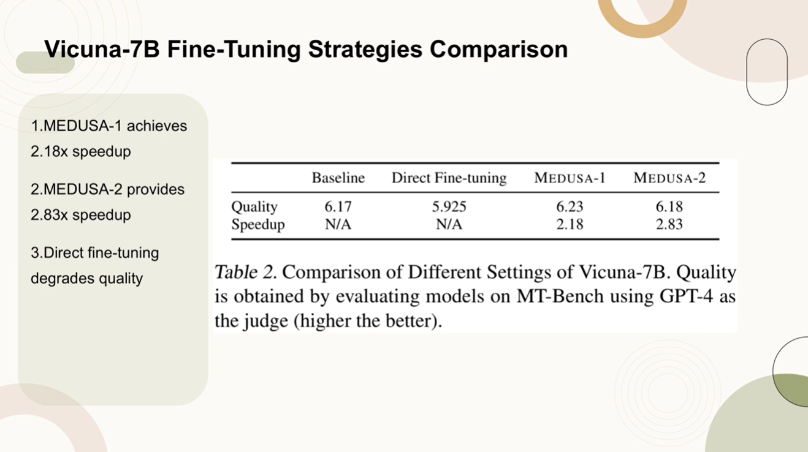
Medusa: Simple LLM Inference Acceleration Framework with Multiple Decoding Heads
20/23

Slide 24
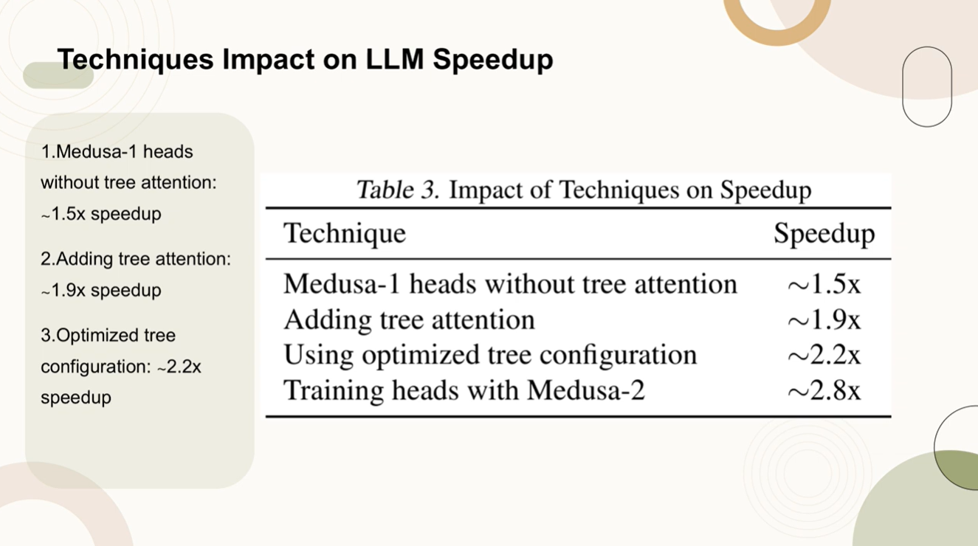
Medusa: Simple LLM Inference Acceleration Framework with Multiple Decoding Heads
1/20

Slide 25
END
2.11.2026

Slide 26
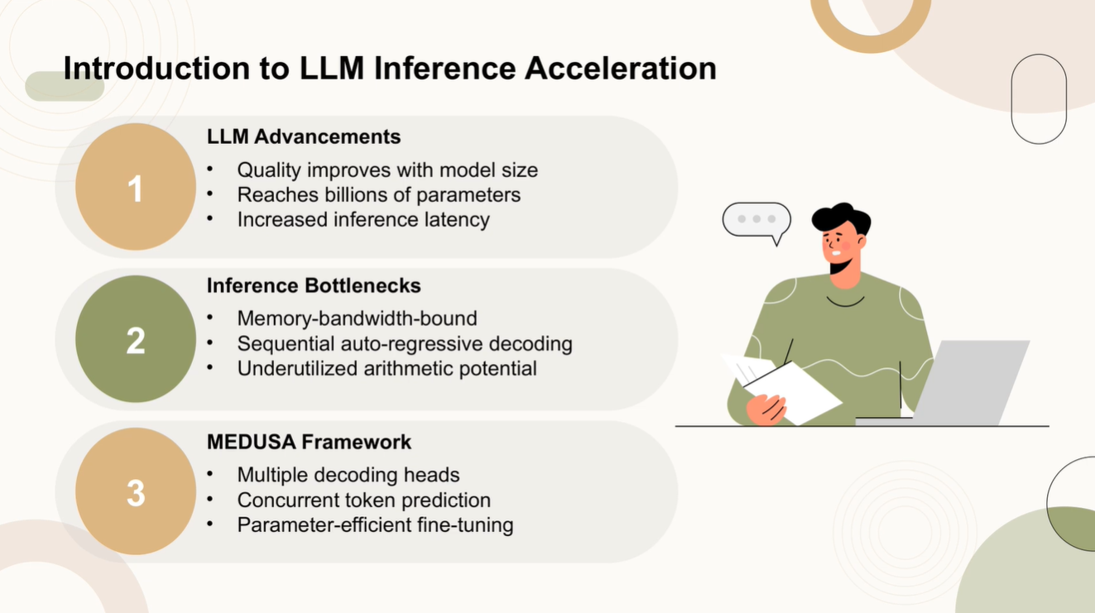
Medusa: Simple LLM Inference Acceleration Framework with Multiple Decoding Heads
1/20

Slide 27
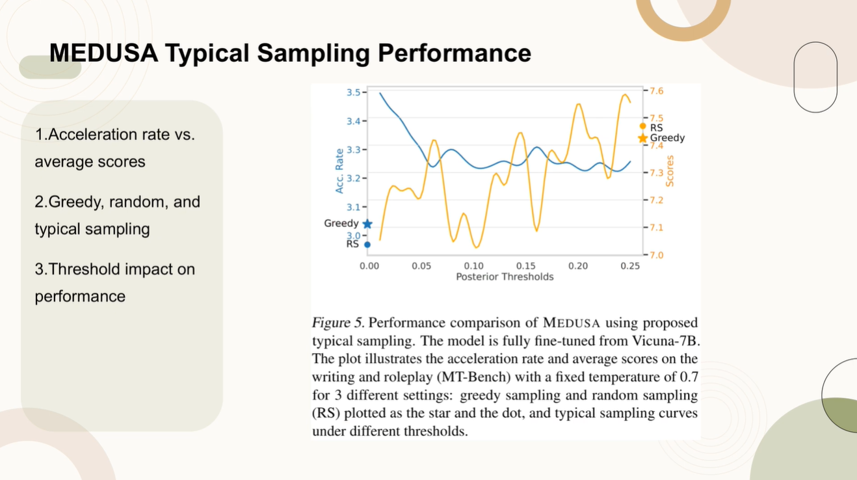
Medusa: Simple LLM Inference Acceleration Framework with Multiple Decoding Heads
1/20

Slide 28
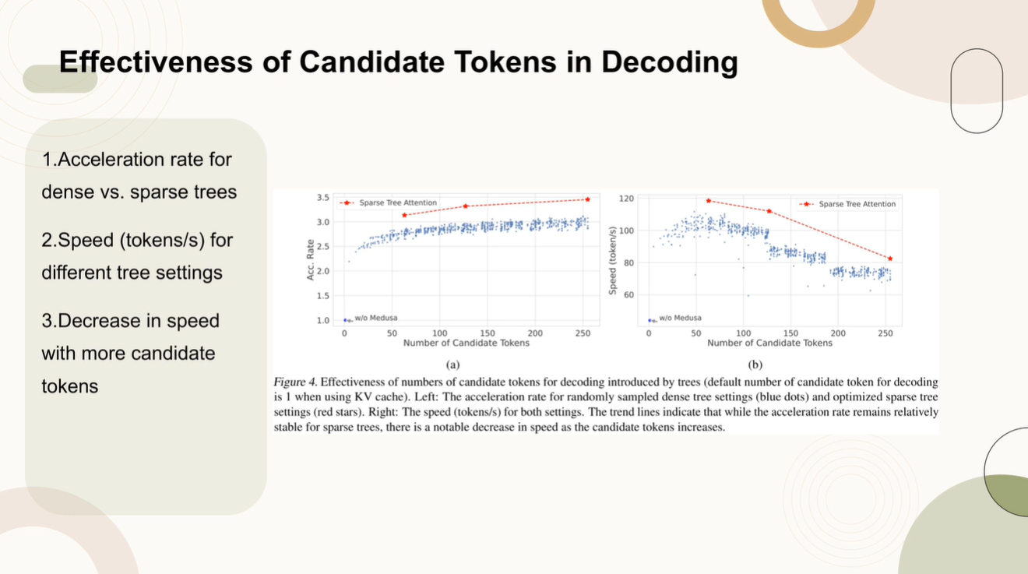
Medusa: Simple LLM Inference Acceleration Framework with Multiple Decoding Heads
1/20

Slide 29
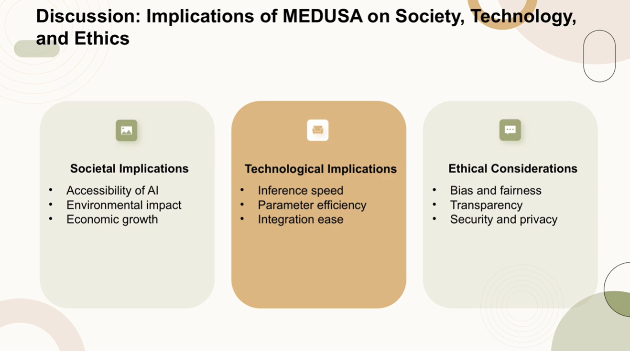
Medusa: Simple LLM Inference Acceleration Framework with Multiple Decoding Heads
1/20

